Slide 1

deCode 2016 Kickoff
Oct 14, 2016

Slide 2

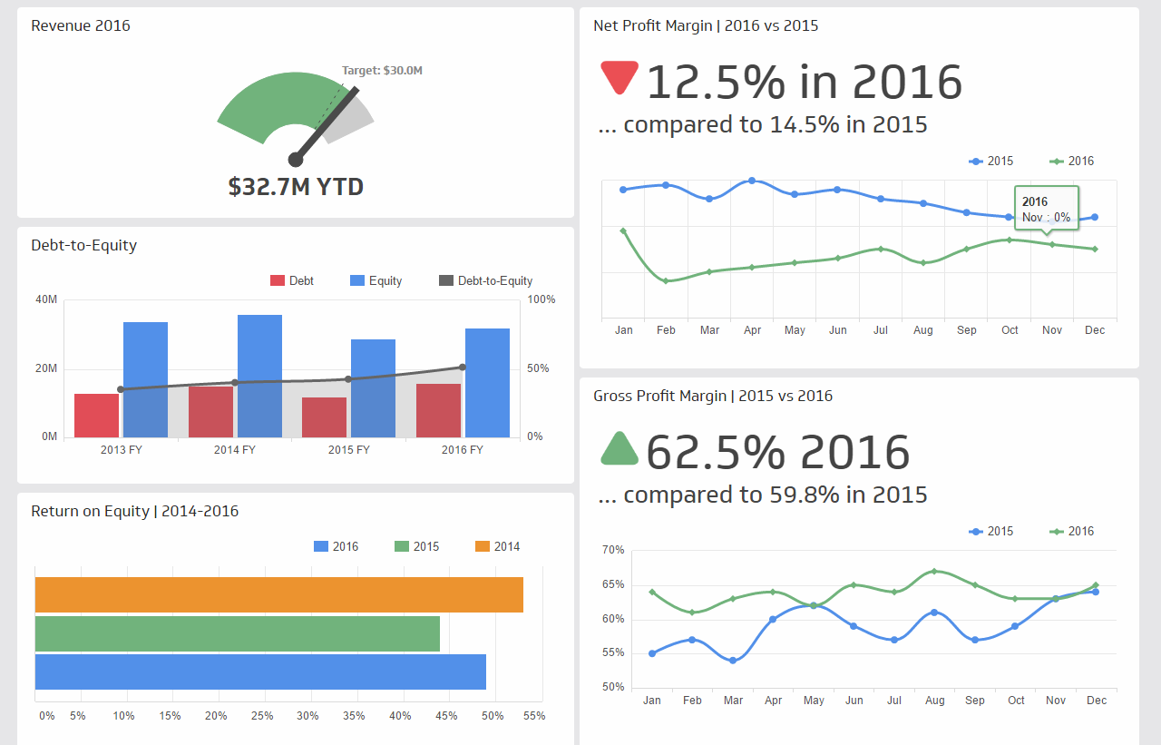
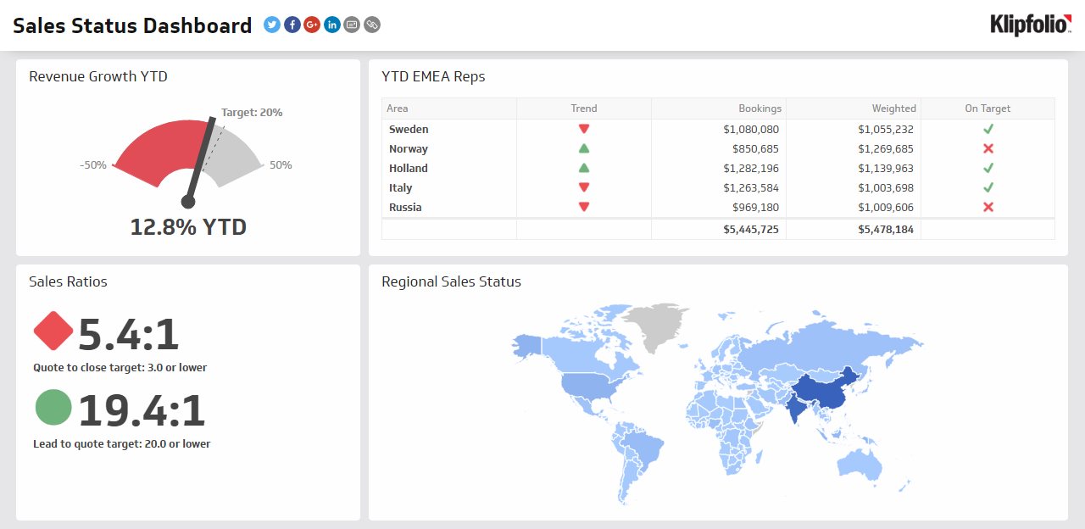
Who are we?
We are passionate about data analytics and dashboards and we love our small/medium size business clients!

Slide 3




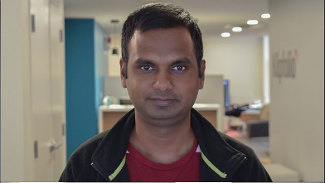

Your Coaches
We are here to help you succeed!
Mark Priatel
Ali Pourshahid
Qing Wei
Gianna Mauro
Md Islam
Chris Poirier

Slide 4
The Project
Building interactive visualizations using time series data with analytic (predictive, correlation, outliers etc) capabilities.

Slide 5
The Story
At Klipfolio, we provide customers with the tools to build meaningful visualizations with their data. The better the tools, the less work they have to do themselves.
Your goal is to create a proof of concept data analysis tool capable of ingesting time series data and predicting the future trend.

Slide 6
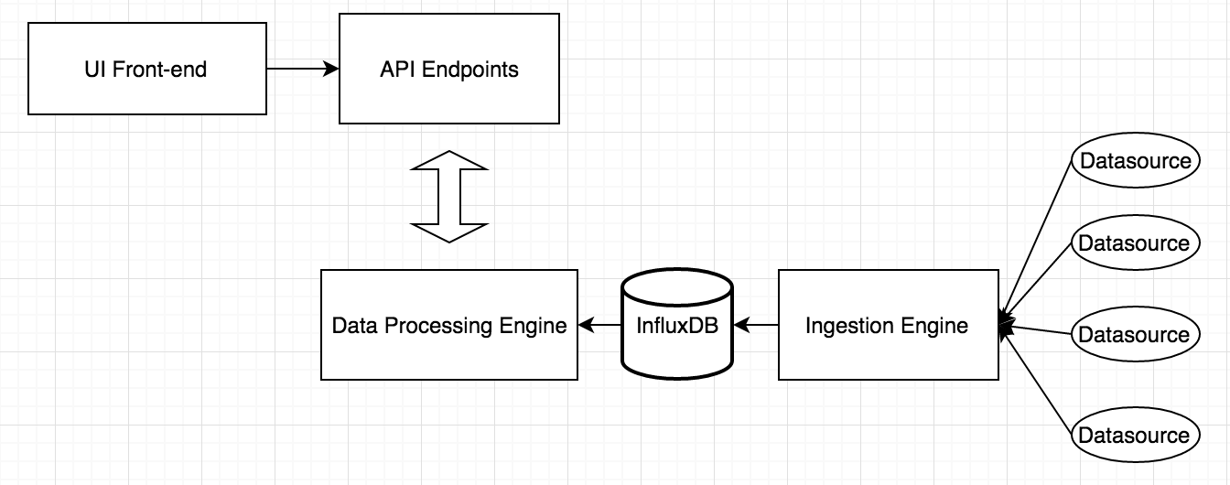
Architecture
Things to consider when you design:
Keep your architecture open and flexible
Use clean API for communication between services.
Allow data ingestion from different data sources.
Allow for the possibility of plugging in different analytics algorithms.

Slide 7
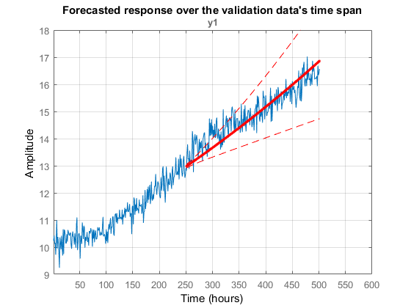
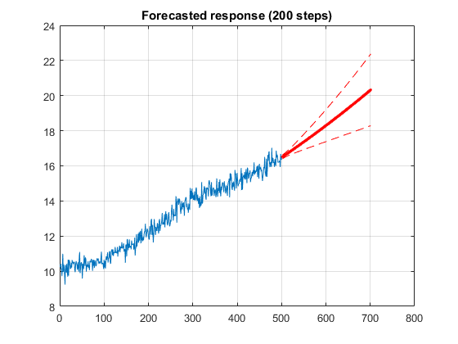
Examples (Forecasting)
Example of a time series visualization where the existing data is divided into Input & Validation segments.
Example of a prediction of time series data (in red). Dashed red lines indicate confidence intervals

Slide 8
Technologies
Chosen Technology
Web Server: nodejs/express
Time series database: InfluxDB
Collaboration: github
Other Recommended Technology
Charting engine: chart.js
Forecasting library: npm timeseries-analysis
Environment Setup: docker/vagrant (if anyone is an expert on it)
Forecasting algorithms
A good intro: https://www.analyticsvidhya.com/blog/2016/02/time-series-forecasting-codes-python/
Useful NPMs:
github, influx, express

Slide 9
Data Sources and APIs
Github has pretty good API where you can get your time series data for your project.
https://developer.github.com/v3/
If you are adventurous and want to find some alternatives for the demo, here are a few more:
A great list of public APIs: https://github.com/toddmotto/public-apis
NASA API: https://api.nasa.gov/planetary/earth/imagery?lon=100.75&lat=1.5&date=2014-02-01&cloud_score=True&api_key=DEMO_KEY
Stackoverflow API: https://api.stackexchange.com/

Slide 10
Milestones
Here are a few milestones (checkpoints) to help keep our project on track.
Milestone 1:
Creating End-to-End time series visualization without any analytics. Including ingesting data from external source to InfluxDB and services the data to UI frontend via a REST API. Then generating a time series chart using the chosen charting library.
Milestone 2:
Building one simple forecasting capability into the application.
Milestone 3:
Building multiple forecasting capabilities which can be selected from UI. Each forecasting algorithm could have their own parameter controls.
Stretch Goal:
Adding a correlation analysis capability to the application.
Alternatively, adding outlier detection capability to the application and visualize outliers.

Slide 11
Agenda: Day 1
Project Kickoff | 20m
Team setup, networking, brain-storming, planning | 1hr
Dev Env Setup | 30m
Coding | Until Lunch
Lunch Break
Scurm | 10m
Coding | Until end of day
End of Day 1 Demo

Slide 12
Agenda: Day 2
Scrum | 10m
Completing the project | Until lunch
Lunch break
Demo Preparation | Until Demo Time
Have an awesome demo!
(Scrums are short update meetings)

